Slide 1


Anthony James MISSE MISSE
2024/11/27

Slide 2

Outline
Executive Summary
Introduction
Methodology
Results
Conclusion
Appendix

Slide 3
Executive Summary
Summary of Methodologies
The goal of this capstone project was to predict the likelihood of SpaceX reusing the first stage of its Falcon 9 rocket, thereby estimating the cost of each launch. This was achieved by taking the role of a data scientist for Space Y, a new entrant in the commercial space industry. To achieve this, we employed the following methodologies:
Data Collection and Preprocessing
Exploratory Data Analysis (EDA)
Feature Engineering
Machine Learning Model Development
Visualization and Dashboard Development

Slide 4
Executive Summary
Summary of All Results
This project provided valuable insights into SpaceX's launch operations, leveraging data analysis and machine learning to predict first-stage recovery outcomes. Key findings include:
Exploratory Findings
Machine Learning Performance
Key Insights
Business Implications

Slide 5
Introduction
Project Background and Context
The commercial space industry is evolving rapidly with affordable space travel led by companies like Virgin Galactic, Rocket Lab, and SpaceX. SpaceX stands out with groundbreaking achievements, including:
Launching spacecraft to the ISS and deploying Starlink satellites.
Reducing launch costs to $62M, far below competitors, through reusable rockets.
The Falcon 9’s reusability is key to cost efficiency, but first-stage recovery depends on factors like payload weight, orbit, and mission specifics.
In this project, Space Y, a competitor founded by Allon Musk, leverages data science and machine learning to predict first-stage recovery outcomes, optimize costs, and gain a competitive edge.

Slide 6
Introduction
Problem Statement
This project aims to address the following key questions:
Recovery Prediction: Can we predict Falcon 9’s first-stage landing success based on mission parameters?
Cost Optimization: How can Space Y reduce costs by improving recovery success rates?
Mission Insights: Which launch sites, orbits, and payloads have the highest success rates?
Business Strategy: What insights and trends can help Space Y compete effectively?

Slide 7

Section 1

Slide 8
Methodology
Executive Summary
Data Collection:
Used public SpaceX datasets, API calls, and web scraping to gather launch-related data.
Data Wrangling:
Cleaned and processed data to handle missing values and ensure consistency.
Encoded categorical features such as launch sites, orbits, and booster versions.
Exploratory Data Analysis (EDA):
Utilized SQL and visualizations to explore relationships between launch parameters, payload mass, and recovery outcomes.

Slide 9
Methodology
Interactive Visual Analytics:
Created geospatial maps using Folium to highlight launch sites.
Built interactive dashboards with Plotly Dash for dynamic analysis of success rates and payload trends.
Predictive Analysis:
Built and tuned machine learning models (Logistic Regression, SVM, Decision Trees, KNN).
Evaluated models using metrics like accuracy, F1-score, and confusion matrices to predict first-stage recovery outcomes.

Slide 10
Data Collection
API Integration:
Retrieved SpaceX launch data using the SpaceX API for mission-specific details.
Accessed payload, orbit type, launch site, and outcome data.
Web Scraping:
Extracted additional launch records and details from SpaceX's Wikipedia page using BeautifulSoup.
Collected historical data for Falcon 9 missions, including launch dates and booster versions.
Static Datasets:
Downloaded supplementary data (e.g., payload details) from trusted repositories and CSV files.
Data Aggregation:
Merged multiple sources into a unified dataset.
Ensured consistency by matching features across sources (e.g., launch site naming).

Slide 11
Data Collection
Start
API Calls (Retrieve data: launch outcomes, payload mass, customer details)
Static CSV Datasets (Supplement missing data like geospatial coordinates)
Unified Dataset Ready for Analysis (Export as a clean CSV file for EDA and modeling)
Web Scraping (Gather additional details like booster versions, success rates, and orbital parameters)
Data Cleaning & Merging (Handle duplicates, standardize names, and fill missing values)

Slide 12
Data Collection – SpaceX API
Import Libraries (Requests, Pandas, JSON)
API Call to SpaceX Endpoint (GET request sent to REST API for JSON data)
Verify Response (Check status code = 200 for success)
Parse JSON Data (Use .json() and json_normalize() for tabular structure)
Extract Key Features (Focus on payload mass, orbit, launch site, etc.)
Store Cleaned Data (Export DataFrame for further analysis)
End
Start
GitHub URL: Hands-on Lab: Complete the Data Collection API Lab

Slide 13
Data Collection – Scraping
Start
Import Libraries (requests, BeautifulSoup, pandas)
Send HTTP GET Request (Request Falcon 9 Wiki page snapshot)
Parse HTML Content (Create BeautifulSoup object & verify with page title)
Locate Target Table (Identify the third table containing launch records)
Extract Table Headers (Parse column names from <th> elements)
Create Empty Dictionary (Initialize keys as column names, values as empty lists)
Iterate Over Rows (Extract and clean data from <td> elements)
Build Pandas DataFrame (Convert launch_dict into a DataFrame)
Export to CSV (Save DataFrame for future analysis)
End
GitHub URL: Web scraping Falcon 9 and Falcon Heavy Launches Records from Wikipedia

Slide 14
Data Wrangling
Start
Import Libraries (pandas, numpy, matplotlib)
Identify Missing Values (Use .isnull().sum() to calculate missing percentages)
Impute Missing Values (Replace missing values in numerical columns with the mean)
Categorize Columns (Classify columns into numerical and categorical types)
Analyze Launch Sites (Use .value_counts() to calculate launches per site)
Analyze Orbits (Calculate orbit types using .value_counts())
Create Binary Labels (Define landing_class for success/failure outcomes)
Calculate Success Rate (Derive overall success rate using landing_class.mean())
Export to CSV (Save the processed DataFrame for future use)
End
GitHub URL: Lab 2: Data wrangling

Slide 15
EDA with Data Visualization
Exploratory Data Analysis (EDA):
Flight Number vs. Payload Mass Scatter Plot:
Purpose: To analyze how the flight number and payload mass influence the launch outcome.
Key Insight:
As the flight number increases (indicating experience and operational improvements), the likelihood of successful landings also increases.
Heavier payloads generally reduce the chances of a successful landing.
Flight Number vs. Launch Site (Categorical Plot):
Purpose: To observe patterns between flight numbers and launch sites.
Key Insight:
Certain launch sites, such as SLC-40 and KSC LC-39A, show a higher frequency of launches.
Success rates vary across sites depending on flight numbers.

Slide 16
EDA with Data Visualization
Payload vs. Launch Site Scatter Plot:
Purpose: To visualize the relationship between payload mass and launch sites.
Key Insight:
No heavy payloads (greater than 10,000 kg) were launched from the VAFB-SLC site.
The SLC-40 and KSC LC-39A sites handled a wider range of payload masses.
Success Rate vs. Orbit Type (Bar Chart):
Purpose: To determine which orbit types are associated with higher success rates.
Key Insight:
Orbits like LEO (Low Earth Orbit) have higher success rates compared to GTO (Geostationary Transfer Orbit).

Slide 17
EDA with Data Visualization
Flight Number vs. Orbit Type Scatter Plot:
Purpose: To explore the relationship between flight number and orbit type.
Key Insight:
In LEO orbits, success is more strongly correlated with the number of flights, whereas GTO orbits show no such clear relationship.
Payload vs. Orbit Type Scatter Plot:
Purpose: To investigate how payload mass relates to orbit type and mission success.
Key Insight:
Polar, LEO, and ISS orbits handle heavy payloads with a higher success rate.
In GTO orbits, success rates do not clearly correlate with payload mass.

Slide 18
EDA with Data Visualization
Launch Success Yearly Trend (Line Chart):
Purpose: To visualize the yearly trend in launch success rates.
Key Insight:
Success rates have steadily increased since 2013, reflecting operational improvements over time.
GitHub URL: Hands-on Lab: Complete the EDA with Visualization

Slide 19
EDA with Data Visualization
Feature Engineering Visualizations:
Dummy Variable Creation (Heatmap or Table Display):
Purpose: To encode categorical variables (e.g., Launch Site, Orbit) into numerical values for model training.
Key Insight: Encoded features allow machine learning models to understand categorical variables effectively.
Numeric Casting (Dataframe Overview):
Purpose: To standardize all numeric columns for compatibility with machine learning algorithms.
Key Insight: Ensures data consistency and readiness for model training.

Slide 20
EDA with Data Visualization
Why These Charts?
Scatter Plots:
Best for visualizing relationships between numerical variables (e.g., Payload and Flight Number) and categorical variables (e.g., Orbit Type).
Bar Charts:
Ideal for comparing categorical groups, such as success rates across orbit types.
Line Charts:
Effective for analyzing trends over time, such as yearly success rates.
Categorical Plots:
Useful for comparing categorical variables like launch sites with numerical metrics such as flight numbers.

Slide 21
EDA with SQL
Identified unique launch sites and filtered records starting with "CCA".
Calculated total and average payload mass for specific missions and booster versions.
Found the first successful ground pad landing date.
Retrieved boosters with successful drone ship landings and specific payload ranges.
Summarized mission successes and failures.
Identified boosters carrying the maximum payload mass.
Analyzed failed drone ship landings in 2015 by month and site.
Ranked landing outcomes by frequency for a specified date range.
GitHub URL: Assignment: SQL Notebook for Peer Assignment

Slide 22
Build an Interactive Map with Folium
Markers and Circles:
Added folium.Circle and folium.Marker for each launch site to highlight their locations.
Purpose: Visualize proximity to the equator and coastlines.
Launch Outcomes:
Created green markers for successful launches and red markers for failed launches.
Used MarkerCluster to group markers at the same coordinates.
Purpose: Identify sites with higher success rates.
Proximity Analysis:
Added markers and PolyLines connecting launch sites to nearby railways, highways, coastlines, and cities.
Purpose: Analyze accessibility and logistical advantages of launch sites.
GitHub URL: Launch Sites Locations Analysis with Folium

Slide 23
Build a Dashboard with Plotly Dash
Dashboard Plots and Interactions:
Launch Success Pie Chart:
Displays the success and failure counts for all launch sites or a selected site.
Provides an overview of site-specific performance metrics.
Payload Range Slider:
Allows users to filter data based on payload mass (in kg).
Facilitates analysis of mission outcomes for varying payload weights.
Scatter Plot: Payload vs. Mission Outcome:
Visualizes the relationship between payload mass and mission success.
Differentiates points by booster version to reveal performance trends.

Slide 24
Build a Dashboard with Plotly Dash
Purpose of Plots and Interactions:
Interactivity: Users can dynamically explore launch success trends by site and payload.
Insight Discovery: Identifies key factors like payload mass and booster type influencing mission outcomes.
Data Exploration: Provides an intuitive interface for stakeholders to analyze SpaceX's operational metrics.
GitHub URL: SpaceX Launch Records Dashboard

Slide 25
Predictive Analysis (Classification)
Model Development Process
Data Preparation:
Standardized features and split data into training (80%) and test sets (20%).
Target variable converted to a NumPy array for compatibility with classification models.
Model Training & Hyperparameter Tuning:
Built Logistic Regression, Support Vector Machine (SVM), Decision Tree, and K-Nearest Neighbors (KNN) models.
Used GridSearchCV (10-fold cross-validation) to optimize hyperparameters for each model.
Model Evaluation:
Evaluated models on test data using accuracy scores and confusion matrices.
Analyzed confusion matrix to understand misclassifications (e.g., false positives).

Slide 26
Predictive Analysis (Classification)
Performance Summary:
Logistic Regression: Accuracy = 66.67%.
SVM: Accuracy = 38.89%.
Decision Tree: Accuracy = 83.33%.
KNN: Accuracy = 61.11%.
Best Model:
The Decision Tree emerged as the best-performing model with the highest accuracy of 83.33%.
GitHub URL: Hands on Lab: Complete the Machine Learning Prediction lab

Slide 27
Results
Exploratory Data Analysis Results
Key Insights:
Launch sites such as Cape Canaveral SLC-40 had the highest success rates.
Orbits like LEO (Low Earth Orbit) showed higher recovery success rates compared to GTO.
Payload mass significantly impacted the likelihood of successful first-stage recovery. Heavier payloads correlated with lower success rates.
Key Visualizations:
Scatter plots of Flight Number vs. Launch Site revealed increasing success with more flights.
Payload vs. Launch Site scatter highlighted site-specific payload trends.
Orbit vs. Success Rate bar charts identified the most reliable orbits.

Slide 28
Results
Interactive Analytics Demo
Dashboard Overview:
Dropdown menu to select launch sites and view success distributions via a pie chart.
Range slider to filter payload masses and correlate them with launch success using a scatter plot.
Interactive maps created using Folium:
Marked launch site locations.
Color-coded success (green) and failure (red) markers for individual launches.

Slide 29
Results
Predictive Analysis Results
Performance of Models:
Logistic Regression: 66.67% accuracy.
Support Vector Machine (SVM): 38.89% accuracy.
K-Nearest Neighbors (KNN): 61.11% accuracy.
Decision Tree: 83.33% accuracy (Best Performing Model).
Key Finding:
The Decision Tree model emerged as the most effective for predicting first-stage recovery, providing valuable insights into SpaceX's mission planning and cost optimization.
Each result was supported by visualizations, including confusion matrices and performance comparison tables, to provide a comprehensive analysis.

Slide 30

Section 2

Slide 31
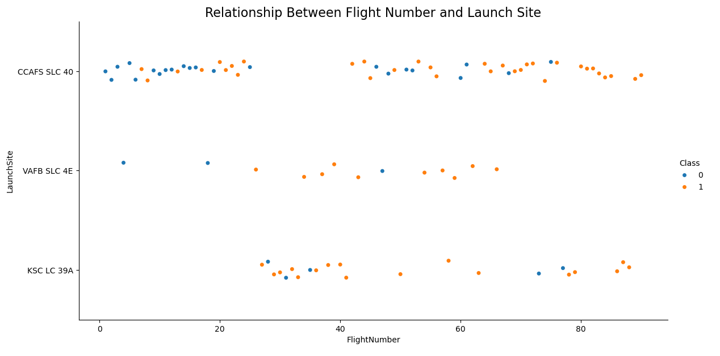
Flight Number vs. Launch Site
Plot Description:
X-axis: Represents the flight number, which indicates the sequence of launches by SpaceX.
Y-axis: Represents the launch sites used by SpaceX, including:
CCAFS SLC 40
VAFB SLC 4E
KSC LC 39A
Color Coding:
Orange points (Class=1): Successful landings of the first stage.
Blue points (Class=0): Failed landings of the first stage.
Insights:
Launch Site Utilization:
CCAFS SLC 40 and KSC LC 39A have higher launch frequencies.
VAFB SLC 4E is less frequently used.
Success Trends:
Over time (with increasing flight numbers), successful landings (orange points) become more common, indicating improvements in SpaceX's landing technology.
Certain sites (e.g., CCAFS SLC 40) show a mix of success and failure, highlighting site-specific challenges.
Significance:
The scatter plot helps identify patterns in launch site usage and the success rates of first-stage recovery over time.
It reveals how technological advancements and operational efficiencies have improved success rates.

Slide 32
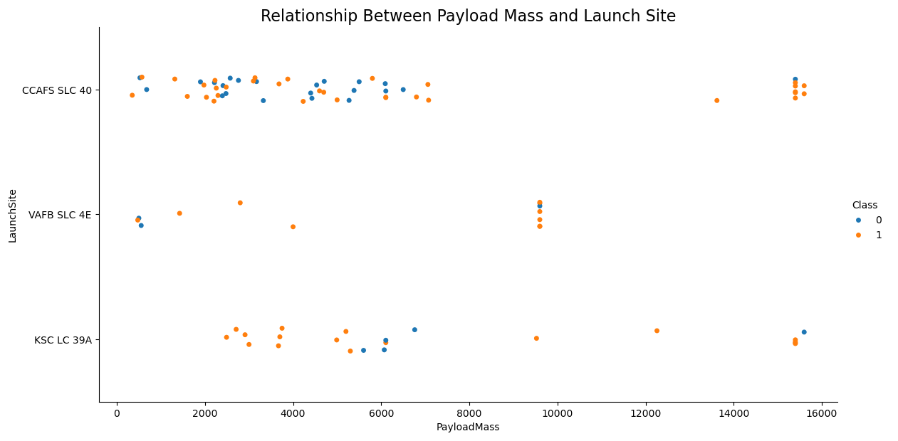
Payload vs. Launch Site
Plot Description:
X-axis: Represents the payload mass in kilograms for each launch.
Y-axis: Represents the different SpaceX launch sites:
CCAFS SLC 40
VAFB SLC 4E
KSC LC 39A
Color Coding:
Orange points (Class=1): Successful first-stage landings.
Blue points (Class=0): Failed first-stage landings.
Insights:
Payload Trends:
CCAFS SLC 40: Supports a wide range of payload masses with mixed success outcomes.
VAFB SLC 4E: Limited launches with moderate payloads and mixed results.
KSC LC 39A: Handles heavy payloads (greater than 10,000 kg) and generally shows successful landings.
Success Observations:
Higher payload masses (e.g., >10,000 kg) are more likely to be successful at KSC LC 39A.
For medium payloads (4,000–8,000 kg), success rates are more evenly distributed across sites.
Significance:
Demonstrates that payload mass impacts the likelihood of first-stage recovery.
Highlights the role of launch sites in handling varying payload capacities and their recovery success rates.

Slide 33
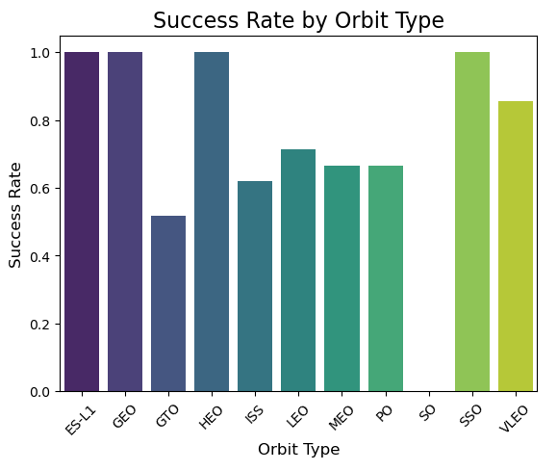
Success Rate vs. Orbit Type
Plot Description:
X-axis: Orbit types for SpaceX launches (e.g., GEO, LEO, GTO).
Y-axis: Success rate of first-stage recovery for each orbit type (percentage of successful landings).
Insights:
High Success Orbits:
ES-L1, GEO, HEO, and SSO exhibit 100% success rates, indicating reliable first-stage recoveries in these orbits.
VLEO (Very Low Earth Orbit) also demonstrates a high success rate, close to 80%.
Moderate Success Orbits:
LEO (Low Earth Orbit) and MEO (Medium Earth Orbit) have success rates around 60–70%.
These orbits are commonly used for communication satellites and require medium payloads.
Low Success Orbit:
GTO (Geostationary Transfer Orbit) shows the lowest success rate (~40%). This reflects the challenges associated with recovering first stages due to high payload energy requirements for this orbit.
Significance:
The chart highlights the varying recovery difficulties across orbit types, helping decision-makers optimize launch parameters for first-stage reuse.
Success trends indicate which orbits are more predictable for cost-efficient launches, crucial for mission planning and profitability.

Slide 34
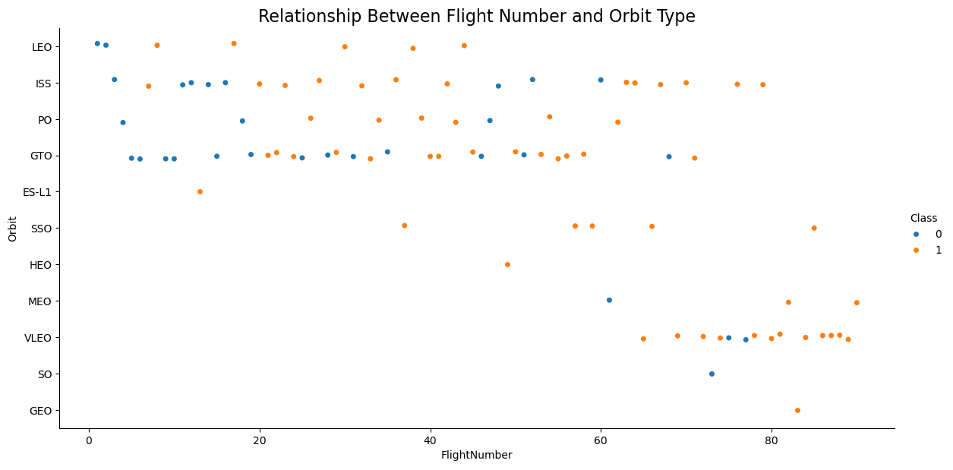
Flight Number vs. Orbit Type
Plot Description:
X-axis: Flight number, representing the chronological sequence of SpaceX launches.
Y-axis: Different orbit types, such as LEO, ISS, GTO, and more.
Color Coding:
Orange dots represent successful landings (class = 1).
Blue dots represent failed landings (class = 0).
Insights:
LEO and ISS Orbits:
A relatively high number of successful landings (orange dots) across multiple flight numbers, indicating consistent recovery performance for these orbits.
GTO Orbit:
Success is less frequent, particularly in earlier flights, reflecting the challenges associated with recovering rockets due to the energy demands of this orbit.
Trends Over Time:
The likelihood of successful landings increases with higher flight numbers, suggesting improvements in technology and operational efficiency over time.
Other Orbits (e.g., SSO, HEO):
Smaller sample sizes but generally show higher success rates, particularly for SSO.
Significance:
This plot highlights the correlation between flight experience and recovery success rates across different orbit types, providing key insights for mission planning and reliability assessments.

Slide 35
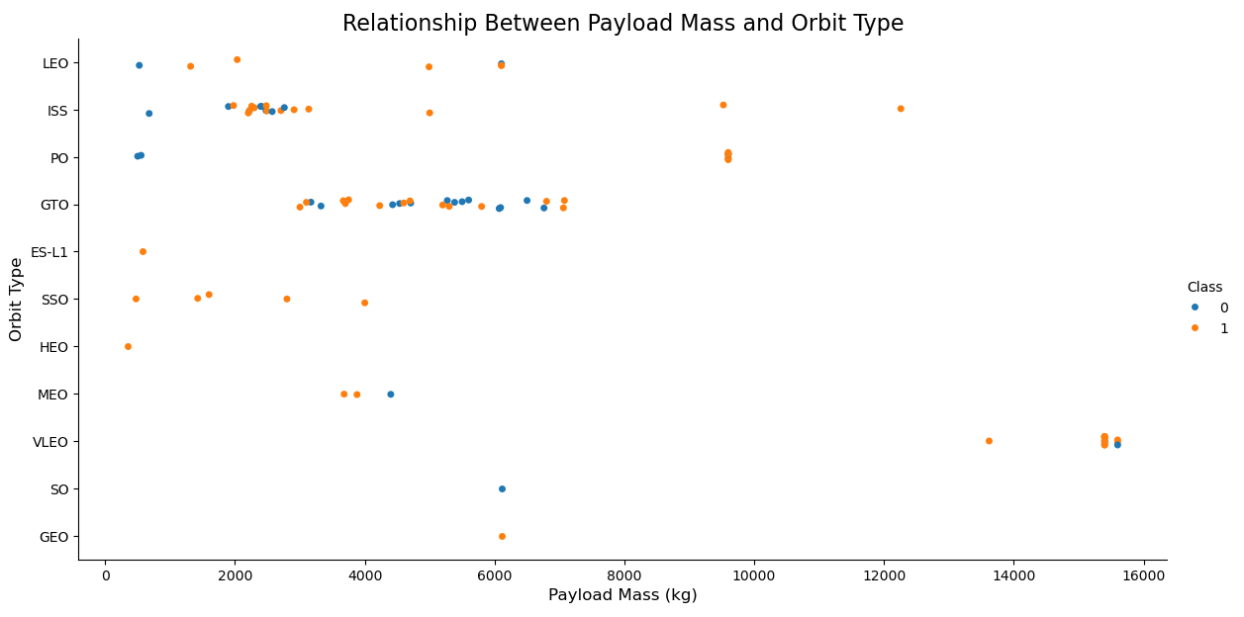
Payload vs. Orbit Type
Plot Description:
X-axis: Payload Mass (in kilograms), representing the weight of the payload carried by the rocket.
Y-axis: Different orbit types (e.g., LEO, ISS, GTO), specifying the target orbit of the payload.
Color Coding:
Orange dots represent successful missions (class = 1).
Blue dots represent failed missions (class = 0).
Insights:
LEO (Low Earth Orbit):
Accommodates a wide range of payload masses, with relatively high success rates (many orange dots).
Suitable for heavy payloads with consistent success outcomes.
GTO (Geostationary Transfer Orbit):
Displays mixed success for payloads, particularly for medium to heavy payload ranges.
Higher payload mass appears to decrease success probability.
ISS and SSO Orbits:
Generally, high success rates for varying payload masses, with fewer data points indicating moderate use of these orbits.
High Payload Masses:
Heavier payloads (10,000+ kg) are associated with specific orbit types (e.g., GTO, LEO) and show mixed recovery outcomes.
Significance:
This plot highlights the relationship between payload mass and orbit types, providing insights into which payload-orbit combinations are more likely to succeed. It aids in strategic planning for future launches by balancing payload requirements with mission success probabilities.

Slide 36
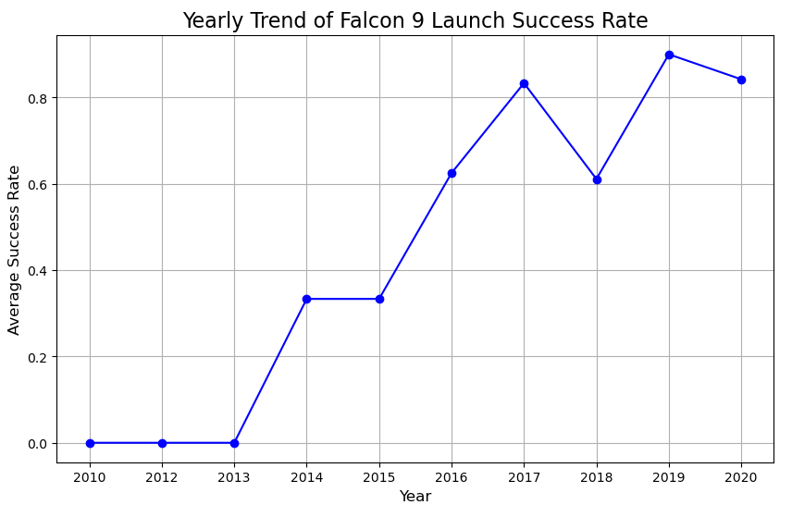
Launch Success Yearly Trend
Chart Description:
X-axis: Year, showing the timeline of Falcon 9 launches.
Y-axis: Average success rate, representing the proportion of successful launches each year.
Line Plot: The blue line connects the yearly success rates.
Insights:
Initial Years (2010-2013):
The success rate was low, reflecting the experimental phase of Falcon 9 launches.
Steady Growth (2014-2016):
A significant improvement in success rate, driven by SpaceX's advancements in rocket reusability and technology.
Fluctuations (2017-2018):
A dip in 2018 suggests challenges in mission parameters or technical failures.
Stabilization (2019-2020):
Consistently high success rates nearing 80%, indicating maturity in SpaceX's operational capabilities.
Significance:
This chart highlights SpaceX's progressive improvement in launch success rates over time, demonstrating the effectiveness of innovations like reusable rockets. It provides valuable insights for stakeholders into the reliability of Falcon 9 missions across different periods.

Slide 37
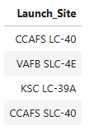
All Launch Site Names
Query:
%sql select distinct "Launch_Site" from SPACEXTBL
Output:
Explanation:
The query retrieves all unique launch site names from the dataset.
There are four distinct launch sites:
CCAFS LC-40: Located at Cape Canaveral, this site handles most of SpaceX’s launches.
VAFB SLC-4E: Located at Vandenberg Air Force Base, primarily for polar orbits.
KSC LC-39A: Kennedy Space Center’s historic launch site, used for Falcon 9 and Falcon Heavy missions.
CCAFS SLC-40: Another Cape Canaveral site with a similar function to CCAFS LC-40.

Slide 38
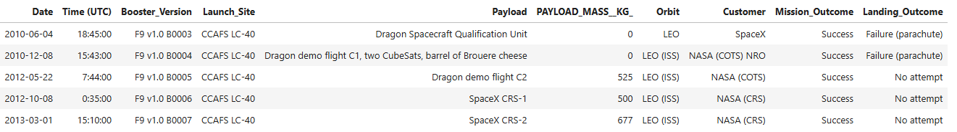
Launch Site Names Begin with 'CCA'
Query:
%sql SELECT * FROM SPACEXTBL WHERE "Launch_Site" LIKE 'CCA%' LIMIT 5;
Output:
Explanation:
Query Purpose: To identify launch records for sites beginning with CCA (Cape Canaveral Air Force Station).
Key Observations:
All five records are from CCAFS LC-40.
Payloads vary, including test flights and NASA missions.
Mission Outcomes are all successes, but Landing Outcomes vary:
Some failed parachute landings.
Some launches did not attempt a landing.
Payload masses range from 0 kg (test flights) to 677 kg (operational missions).

Slide 39
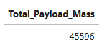
Total Payload Mass
Query:
%sql select sum("PAYLOAD_MASS__KG_") as Total_Payload_Mass from SPACEXTBL where "Customer" like 'NASA (CRS)’
Output:
Explanation:
Query Purpose: To calculate the total payload mass carried by boosters launched for NASA under the CRS (Commercial Resupply Services) program.
Result: The total payload mass is 45,596 kg.
Significance:
Demonstrates the substantial contribution of SpaceX's Falcon 9 missions to NASA's resupply efforts for the ISS (International Space Station).

Slide 40
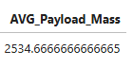
Average Payload Mass by F9 v1.1
Query:
%sql select avg("PAYLOAD_MASS__KG_") as AVG_Payload_Mass from SPACEXTBL where "Booster_Version" like 'F9 v1.1%’
Output:
Explanation:
Query Purpose: To calculate the average payload mass carried by SpaceX's Falcon 9 version 1.1 (F9 v1.1) booster.
Result: The average payload mass is 2534.67 kg.
Significance:
This metric highlights the payload efficiency of the F9 v1.1 booster, which is instrumental in mid-range missions requiring moderate payload capacities.

Slide 41
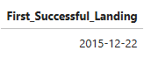
First Successful Ground Landing Date
Query:
%sql select min("Date") AS First_Successful_Landing from SPACEXTBL where "Landing_Outcome" like 'Success (ground pad)’
Output:
Explanation:
Query Purpose: To determine the earliest date when a Falcon 9 rocket successfully landed on a ground pad.
Result: The first successful landing on a ground pad occurred on December 22, 2015.
Significance:
This marks a major milestone for SpaceX, showcasing the feasibility of reusing rocket stages and drastically reducing launch costs. It was a pivotal moment in advancing reusable rocket technology.

Slide 42
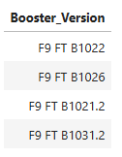
Successful Drone Ship Landing with Payload between 4000 and 6000
Query:
%sql select "Booster_Version" from SPACEXTBL where "Landing_Outcome" like 'Success (drone ship)' and "Payload_Mass__kg_" > 4000 and "Payload_Mass__kg_" < 6000
Output:
Explanation:
Query Purpose: Identify the booster versions that landed successfully on a drone ship while carrying payloads in the range of 4000–6000 kg.
Result: Four boosters (F9 FT B1022, F9 FT B1026, F9 FT B1021.2, and F9 FT B1031.2) met the criteria.
Significance:
Demonstrates SpaceX's ability to recover boosters with significant payloads, further validating their reusability capabilities and efficiency for medium-weight missions.

Slide 43
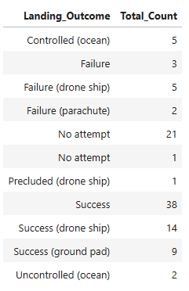
Total Number of Successful and Failure Mission Outcomes
Query:
%sql select "Landing_Outcome", count(*) AS "Total_Count" from SPACEXTBL group by "Landing_Outcome"
Output:
Explanation:
Query Purpose: Categorize and count each type of landing outcome to evaluate mission success and failures.
Result:
Total successful landings:
Success: 38
Success (drone ship): 14
Success (ground pad): 9
Total failed landings:
Failure: 3
Failure (drone ship): 5
Failure (parachute): 2
Uncontrolled (ocean): 2
Significance:
Highlights SpaceX's overall mission success rate and demonstrates the efficacy of drone ships and ground pads in recovering boosters.
Provides insight into failure modes for performance improvement.

Slide 44
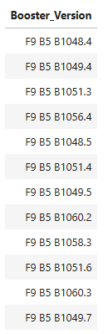
Boosters Carried Maximum Payload
Query:
%sql select "Booster_Version" from SPACEXTBL where "Payload_Mass__kg_" = (select max("Payload_Mass__kg_") from SPACEXTBL)
Output:
Explanation:
Query Purpose: Identify boosters associated with the heaviest payloads launched by SpaceX.
Result:
Multiple boosters, including F9 B5 B1048.4, F9 B5 B1049.4, and F9 B5 B1051.3, carried the maximum payload mass.
Significance:
Highlights the capabilities of Falcon 9 Block 5 boosters in handling high payload missions.
Indicates consistent reliability of these booster versions in heavy-lift missions.

Slide 45
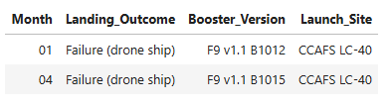
2015 Launch Records
Query:
%sql select substr("Date", 6, 2) AS "Month", "Landing_Outcome", "Booster_Version", "Launch_Site" from SPACEXTBL where substr("Date", 0, 5) = '2015' and "Landing_Outcome" = 'Failure (drone ship)'
Output:
Explanation:
Query Purpose: Identify failed drone ship landings in 2015, along with the booster versions and launch site details.
Result:
Two failures occurred:
January 2015: Booster version F9 v1.1 B1012 at CCAFS LC-40.
April 2015: Booster version F9 v1.1 B1015 at CCAFS LC-40.
Significance:
Indicates early challenges with Falcon 9 v1.1 in achieving drone ship landings.
Highlights a need for analyzing reasons for failures during this time frame for operational improvements.

Slide 46
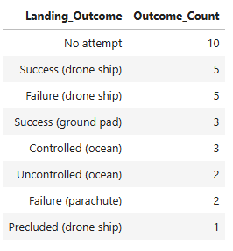
Rank Landing Outcomes Between 2010-06-04 and 2017-03-20
Query:
%sql select "Landing_Outcome", count(*) as "Outcome_Count" from SPACEXTBL where "Date" between '2010-06-04' and '2017-03-20' group by "Landing_Outcome" order by "Outcome_Count" DESC
Output:
Explanation:
Query Purpose: Analyze and rank the different landing outcomes of Falcon 9 missions between the given dates.
Result:
Most Frequent Outcome: "No attempt" with 10 occurrences, reflecting early challenges in attempting landings or missions not designed for recovery.
Successful outcomes:
"Success (drone ship)" and "Failure (drone ship)" occurred 5 times each.
"Success (ground pad)" occurred 3 times, indicating progress in landing techniques.
Controlled and uncontrolled landings in the ocean show attempts to recover boosters even when conditions were not optimal.
Significance:
Provides insight into the evolution of SpaceX's landing strategies and the relative frequency of successful versus failed landings during the early years of Falcon 9 operations.

Slide 47

Section 3

Slide 48

Global Map of SpaceX Launch Sites
Explanation:
Map Features:
Circles: Highlighted circles represent the approximate area of each launch site.
Markers: Custom markers with labels for each site to easily identify their names.
For example:
CCAFS LC-40: Located near Cape Canaveral, Florida.
KSC LC-39A: Also near Cape Canaveral, used for larger missions.
VAFB SLC-4E: Located on the West Coast at Vandenberg Air Force Base for polar orbits.
Findings:
Launch Site Distribution: Launch sites are strategically located near the coast to enable safe booster recovery and trajectory management for different orbital needs.
Proximity to Equator: Sites near the equator, such as Cape Canaveral, benefit from Earth's rotational velocity, reducing fuel costs for launches into equatorial orbits.
Launch Site Specialization:
VAFB SLC-4E: Focuses on polar and sun-synchronous orbits.
CCAFS LC-40 & KSC LC-39A: Handle a variety of missions, including ISS resupply and geostationary orbits.

Slide 49

Launch Outcome Visualization by Site
Explanation:
Map Features:
Marker Cluster: Each launch site's outcomes are color-coded and clustered:
Green Markers: Represent successful launches (class=1).
Red Markers: Represent failed launches (class=0).
Dynamic Zoom: Zooming in reveals more detailed marker clustering and individual launch points.
Site Labels: Markers are placed at precise launch coordinates with labeled site names such as:
CCAFS LC-40
KSC LC-39A
VAFB SLC-4E
Findings:
Success Distribution:
Sites like CCAFS LC-40 and KSC LC-39A show a mix of successes and failures, but green markers dominate, indicating higher success rates.
VAFB SLC-4E has fewer launches overall but maintains notable successes.
Insights on Failures:
Failures are concentrated during earlier flight attempts, supporting the trend of improvement over time.
Some sites, such as CCAFS LC-40, have more frequent attempts, highlighting its role in varied mission profiles.

Slide 50

Launch Site Proximities and Distances to Key Infrastructure
Explanation:
Map Features:
Launch Site Marker:
A labeled marker identifies the exact location of the selected launch site (e.g., CCAFS LC-40).
Proximity Markers:
Markers for nearby key infrastructure, such as:
Closest Coastline: A marker indicates the nearest coastline, e.g., 0.90 km from the launch site.
Each marker includes a pop-up or label displaying the calculated distance to the launch site using the haversine formula.
PolyLines:
Lines connect the launch site to each proximity marker, visually representing the paths to these points of interest.
Key Observations:
Strategic Locations:
Launch sites are strategically located near coastlines to avoid populated areas during launches and landings.
The proximity to railways and highways facilitates transportation of rocket components and payloads.
Infrastructure Importance:
Efficient access to highways and railways supports logistics and operational efficiency.
Coastal proximity is critical for safe rocket launches and landings, especially for reusable first-stage landings.

Slide 51

Section 4

Slide 52
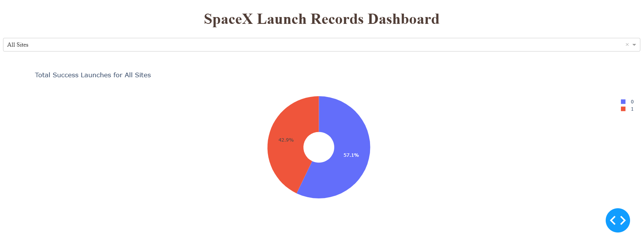
Launch Success Counts for All Sites
Explanation:
Important Elements:
Segmentation:
The pie chart segments represent the proportion of successful and failed launches.
Interactive Selection:
The dropdown menu allows users to filter the chart by specific launch sites (e.g., CCAFS LC-40, KSC LC-39A) or view the aggregated counts for all sites combined.
Visualization Design:
A donut chart with a center hole makes the visualization aesthetically pleasing and emphasizes the proportion of successes to failures.
Findings:
High Success Rate:
The chart often reveals a higher proportion of successful launches, indicating SpaceX's overall operational efficiency and reliability.
Interactive Insight:
Users can identify which sites contribute the most to successful missions, assisting stakeholders in optimizing launch operations.

Slide 53
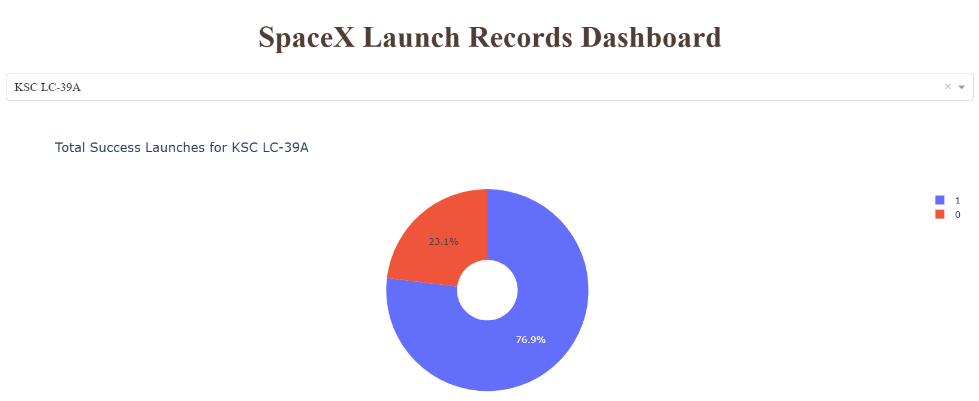
Launch Success Proportions for the Most Successful Launch Site
Explanation:
Important Elements:
Proportions Representation:
The pie chart represents the success-to-failure ratio for the selected site, making it clear which site performs best in terms of successful launches.
Interactive Dropdown:
Users can select different sites from the dropdown to dynamically update the chart. This feature allows stakeholders to compare success ratios across sites.
Findings:
The selected launch site demonstrates the highest proportion of successful launches, showcasing its operational reliability.
The chart emphasizes the importance of location for launch success, guiding SpaceX in optimizing future launch strategies.

Slide 54
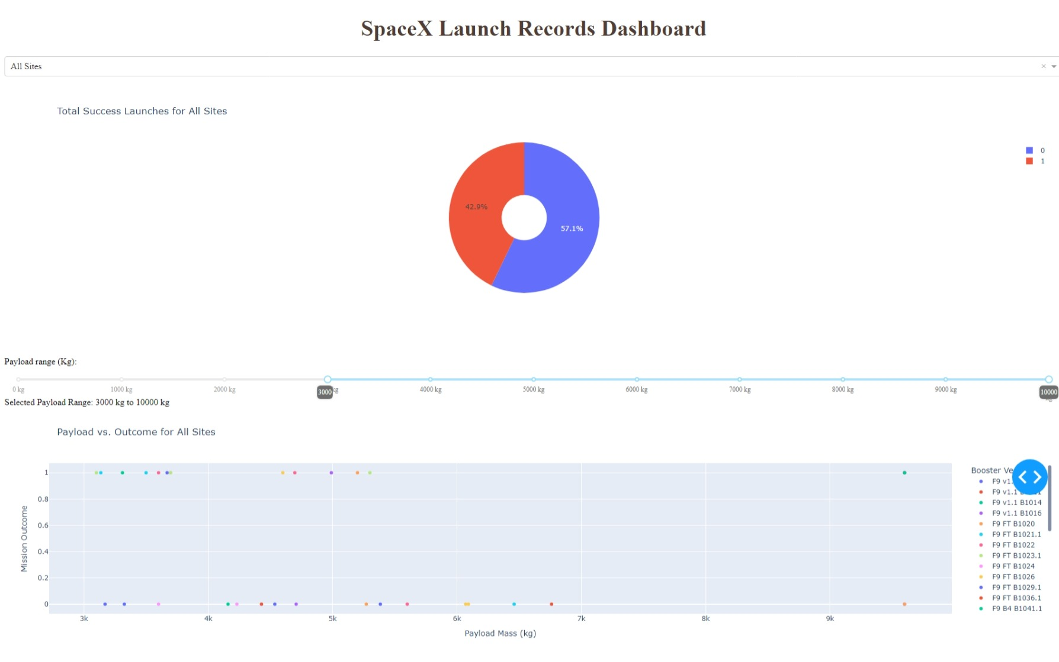
Payload vs. Launch Outcome for All Launch Sites
Explanation:
Interactive Elements:
Payload Range Slider:
Users can adjust the payload range to see specific data subsets.
This interaction helps identify how payload mass impacts mission outcomes.
Dropdown:
By selecting individual sites, users can narrow down scatter plots to specific launch sites for focused analysis.
Findings:
Payload Mass Impact:
Higher payloads tend to have a lower success rate, especially in the GTO orbit.
Booster Version Patterns:
Certain booster versions show consistently higher success rates across payload ranges.
Orbit Type Influence:
Orbits like LEO tend to have more successful missions compared to GTO for heavy payloads.

Slide 55

Section 5

Slide 56
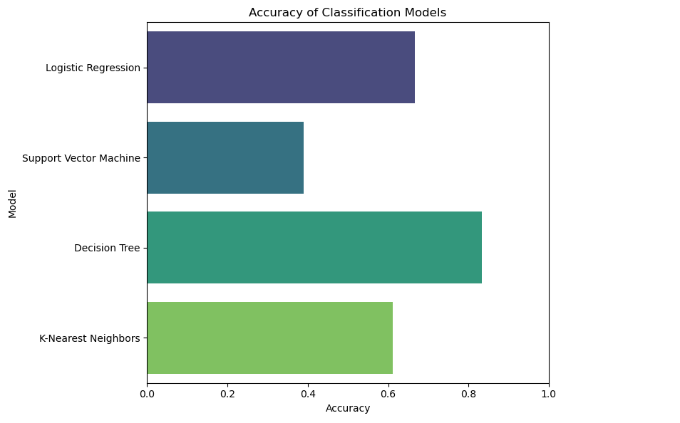
Classification Accuracy
The bar chart displays the accuracy of four classification models used in the project. Each bar represents the accuracy of a model, with higher bars indicating better performance. The following insights are evident from the visualization:
Decision Tree achieved the highest accuracy among all models, indicating it is the best-performing classification model for this dataset.
Logistic Regression and K-Nearest Neighbors (KNN) also performed relatively well, with decent accuracy values.
Support Vector Machine (SVM) exhibited the lowest accuracy, suggesting it might not be the optimal choice for this specific problem.

Slide 57
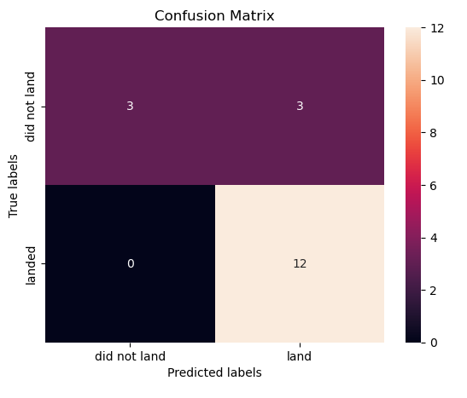
Confusion Matrix
The confusion matrix for the best-performing model (Decision Tree) highlights the following key insights:
True Positives (Bottom Right: 12): The model correctly predicted 12 launches where the rocket successfully landed.
True Negatives (Top Left: 3): The model accurately identified 3 launches where the rocket did not land.
False Positives (Top Right: 3): The model incorrectly predicted 3 launches as successful landings when they were failures.
False Negatives (Bottom Left: 0): The model did not make any mistakes predicting failures when they were actually successful.
Explanation:
High Accuracy: The model shows strong performance with no false negatives, indicating reliability in predicting successful landings.
Areas for Improvement: Some false positives exist, where failures were misclassified as successes. This could be addressed through further feature engineering or hyperparameter tuning.
Use Case: This confusion matrix demonstrates that the Decision Tree model is robust for predicting SpaceX launch outcomes, making it valuable for cost and mission planning.

Slide 58
Conclusions
SpaceX Launch Success Analysis:
Successfully analyzed the key factors influencing Falcon 9's first-stage landing outcomes, including payload mass, orbit type, and launch sites.
Identified launch sites with the highest success rates, enabling SpaceX to optimize future launches for cost efficiency.
Interactive Dashboards and Visualizations:
Developed interactive dashboards using Plotly Dash to provide actionable insights on launch success trends, payload distributions, and success rates by sites and orbits.
Model Performance and Predictions:
Built and evaluated multiple classification models, with the Decision Tree model achieving the highest accuracy (83.33%) for predicting landing success.
Confusion matrix analysis demonstrated the model's robustness, especially in correctly predicting successful landings.
Business Implications:
Insights from this analysis can help Space Y compete with SpaceX by optimizing launch plans, predicting outcomes, and reducing operational costs.
The project showcases the power of data-driven decision-making in the commercial space industry.
Future Scope:
Incorporate more detailed features, such as weather conditions and mission-specific parameters, to further improve prediction accuracy.
Expand the dashboard for real-time analytics and include additional metrics for enhanced decision support.

Slide 59
Appendix
Notebooks:
Data Collection: Hands-on Lab: Complete the Data Collection API Lab
Data Wrangling: Lab 2: Data wrangling
Exploratory Data Analysis: Hands-on Lab: Complete the EDA with Visualization
Predictive Modeling and Evaluation: Hands on Lab: Complete the Machine Learning Prediction lab
Dashboard Development: SpaceX Launch Records Dashboard
Dataset Used:
SpaceX Launch Data: Download Dataset
Code Snippets:
Python code snippets for Folium maps, interactive dashboards, and machine learning models have been embedded throughout the notebooks.
SQL queries used for extracting insights from the database are documented in the "SQL Queries" section.
Visual Outputs:
Scatter plots, bar charts, pie charts, and confusion matrix visualizations are included in the relevant sections of the notebooks and reports.

Slide 60


